Slide 1
Smart Data Access (SDA)

Slide 2
Smart Data Access (SDA)
Smart Data Access is a powerful new tool to address integration and cost reduction of a landscape, and a foundation technology underlying the SAP Real-Time Data Platform (RTDP).
It is standard functionality built into SAP HANA.
It provides non-disruptive intelligent architecture to provision enterprise-wide data from heterogeneous systems such as Hadoop, Teradata, SAP Sybase ASE and SAP Sybase IQ.
It also provides the capability for SAP HANA to SAP HANA queries which can facilitate SAP NetWeaver Business Warehouse on SAP HANA to SAP Business Suite on SAP HANA.
Customers can easily build unified transactional-analytical applications with secure access to data across their business networks without large data transfers.
All data stores benefit from the superlative in-memory performance and ensuing simplification translating to simpler and iterative application design models.
Faster application development time.

Slide 3
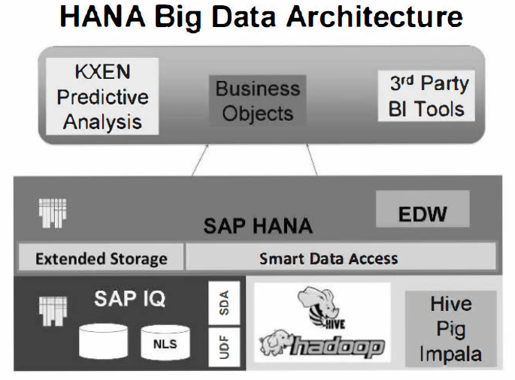

Slide 4
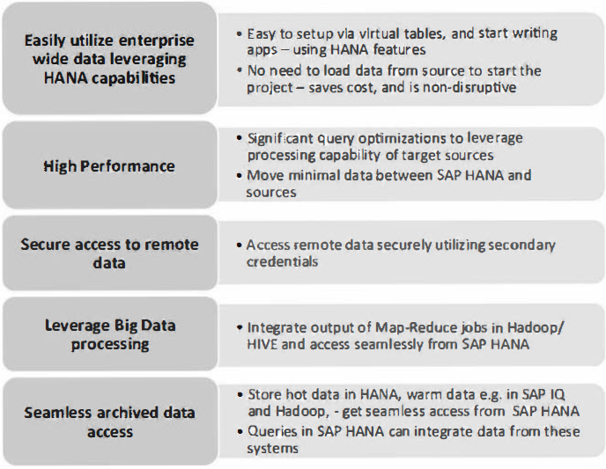

Slide 5
SAP HANA smart data access starts becoming the "glue" of the platform.
Provide a data platform for application developers to write new data intensive analytical applications, without regard to where the data resides, its type, quality, or size
Platform will provide the capability to extract the required information (not data), from a variety of data sources
This will enable the rapid development of these applications, with the highest degree of performance
Enables access to remote data access just like "local" table
No special syntax to access heterogeneous data sources
Smart query processing pushing as much processing as possible to target data source
Automatic data type translation enables remote data types to be mapped to HANA data types
Supports data location agnostic development
Support of Insert, Update and Delete (except Hadoop)
Calculation View Support for Virtual Tables
Deliver Generic Adapter framework to extend additional Remote Sources

Slide 6
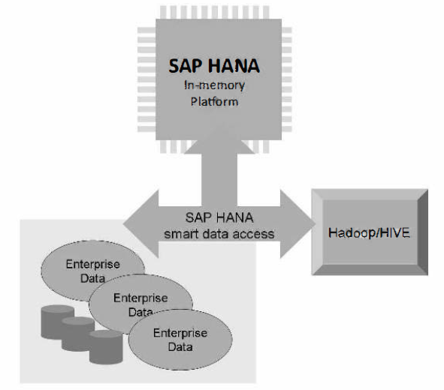
HANA smart data access (Data Virtualization)

Slide 7
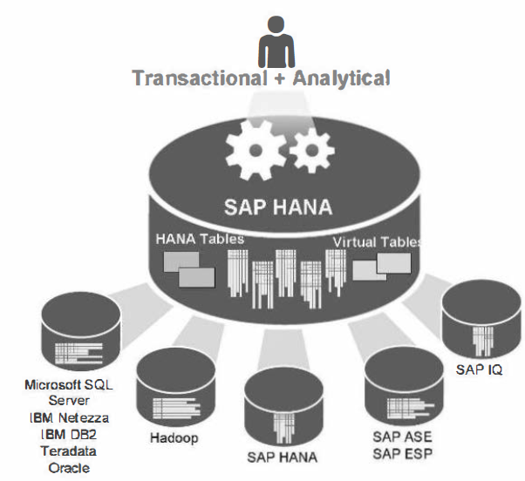
Heterogeneous data sources that you can access are:
Hadoop (Hive)
Teradata
SAP HANA
SAP ASE
SAP IQ
Microsoft SQL Server (from SPS07)
Oracle (from SPS07)
IBM DB2 (from SPS08)
IBM Netezza (from SPS08)
SAP ESP

Slide 8
Configuring and using SDA
Configuring the driver is the only step needed to use HANA smart data access
The first step for configuring Smart Data access it to ensure that the correct drivers for the relevant databases are installed on the SAP HANA server.
Driver Configuration:
Copy the ODBC driver to a HANA directory on the machine HANA is running on
Set the environment variable LD_LIBRARY_PATH to point to the directory that the ODBC driver is in
Optionally, edit the ODBC.INI file to add a DSN entry, or provide the remote server information in the "create remote source" SQL statement.

Slide 9
Configuration Validation Utility - hdbsdautil
You can verify that the drivers have been correctly installed by using the hdbsdautil (HANA Database Smart Data Access Utility).
The utility check drivers and dependency files of given data source type.
Syntax
hdbsdautil -t <data source type> -S <DSN or string> [-U <username> [-P <password>)) [-Q <SQL>] [-nr] [-Info]
Examples
hdbsdautil -t tdodbc -S "dsn=td_dsn" -U test -P test-Info

Slide 10
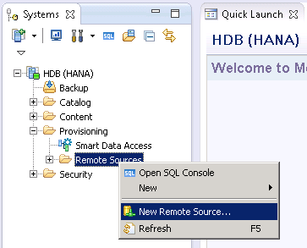
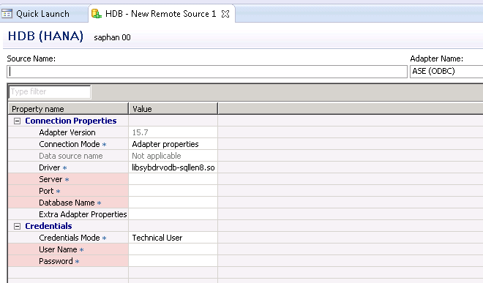
Creating a remote source
Information to fill in:
Adapter Name, Server Name,
Port#, Database Name,
Credentials for remote source
DDL Command:
CREATE REMOTE SOURCE "HANA1" ADAPTER "hanaodbc" CONFIGURATION 'ServerNode=myhanaserver.SAP.CORP:30015;Driver=llbodbcHDB.so' WITH CREDENTIAL TYPE 'PASSWORD' USING 'user=SYSTEM;password=Manager2013';

Slide 11
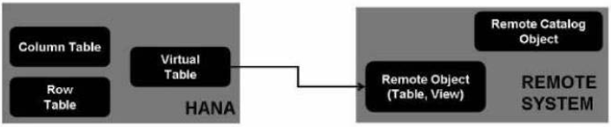
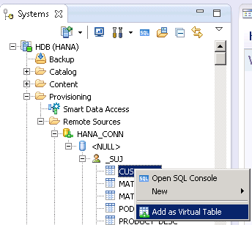
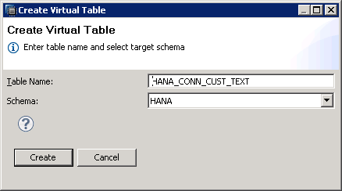
Virtual table
DDL:
CREATE VIRTUAL TABLE my_schema.my_table AT remote_source.catalog.schema.object
Remote Table datatypes, column definitions are used to create the Virtual table
When Virtual table is created, HANA system catalog will be updated to include local column names/ datatypes. remote names/ datatypes, index information, etc

Slide 12
Generic Adapter Framework
If your database is not supported by native database libraries in SAP HANA smart data access yet, you could probably still access it using the Generic Adapter Framework. This uses the relevant ODBC drivers for your database, together with a connectivity configuration file as illustrated.
Provides high performance by reducing data transfer between HANA and remote data source - via query push down (push down filters, aggregates, semi-joins)
Extend the HANA functionality to remote data source via functional compensation. The optimizer is aware when HANA specific features cannot be used and compensates for those
Built-in functions
SQL features not supported in the remote server
Functional translation to deal with syntactical differences between HANA and remote server

Slide 13
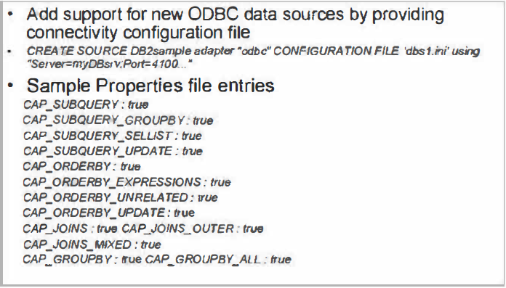
Generic Adapter Framework

Slide 14
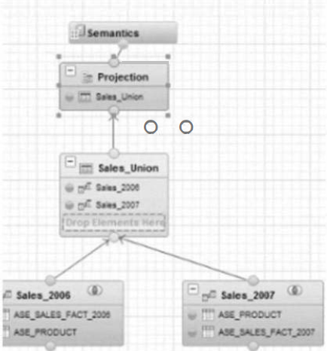
Calculation View support for Virtual Tables
When creating a calculation view, it is possible to add virtual tables as data sources.
Optimizations such as push down of filters is also supported in these Calculation scenarios.
The SQL optimizer in SAP HANA knows what each database is capable of, and send only valid queries to these remote sources .

Slide 15
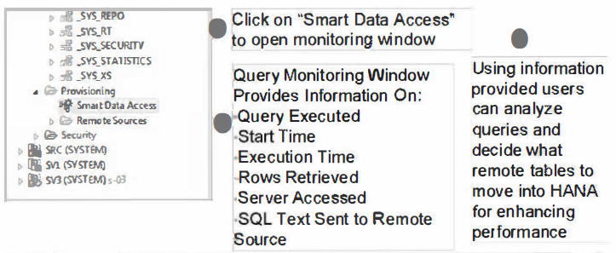
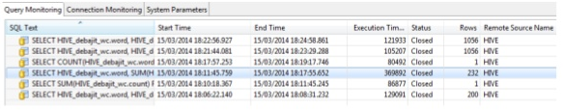
Query Monitoring

Slide 16
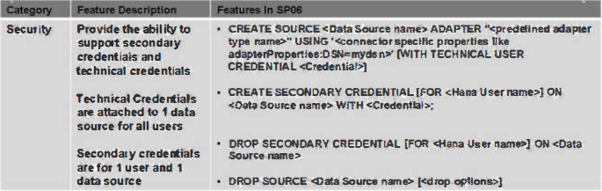
Security Model
Supports the ability to create technical user credential and secondary credential
Technical User Credential:
1 credential attached to 1 data source for ALL HANA Users
Secondary Credential:
1 credential attached to 1 HANA User and 1 Data Source
Credential type: explicit user + password pair

Slide 17
THANK YOU
Courtesy : SAP Labs Document -
HA 350 – Data Provisioning

